Slide 1
Data Structure

Slide 2
Data Structure
Data structure is structural representation of logical relationships between elements of data.
Way of organizing data items by considering its relationship to each other.
Organization of data providing accessing methods with correct degree associatively.
Affects the design of structural and functional aspects
Selection of particular Data Structure Helps programmer to design more efficiency of program
Can be represented in main and auxiliary(file)memory

Slide 3
Data Structures
Array
Structure
Stack
Queue
Linked List
Singly Linked List
Doubly Linked List
Trees
………………….many more

Slide 4
Data Structure
Data Structure
Primitive Data Structure
Non-Primitive Data Structure
integer
float
character
pointer
arrays
lists
files
Linear list
Non linear list
stack
queue
graph
trees

Slide 5
Stack
Stack Implementation
Static Implementation (using arrays)
Not a flexible way
Will not allow to shrink or grow array size
Not an effective way when optimization is concerned(memory utilization)
Dynamic Implementation(using Pointers)
Above all can be over come with this implementation

Slide 6
Applications of Stack
Implicit use in recursion
Explicit use in non recursive function
To evaluate mathematical expressions and parenthesis check.

Slide 7
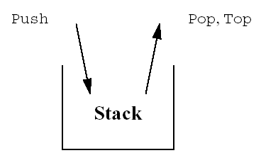
Operations Performed on stack
push – adding element into stack
Stack overflow condition may occur
Full check
pop – removing element from stack
Stack underflow condition may occur
Empty check
Peek – retrive top most element from stack
Operations are performed at one end (i.e. top)
Last In First Out (LIFO)

Slide 8
Algorithm for push
If top == size -1 ,then :
a)Display “The stack overflow condition
b)Exit
Top = top + 1
Stack[top]=element
exit

Slide 9
Algorithm for pop
If top < 0 ,then :
a)Display “The stack underflow/empty condition
b)Exit
Else remove the top most element
Data = Stack[top]
Top = top - 1
exit

Slide 10
Expression
Infix notation used in general mathematics where operator comes in between operands
A + B
Prefix Notation
Operator is written before operands. ( + AB)
Postfix Notation
Operator is written after operands. (AB+)

Slide 11
The rules to be remembered during infix to postfix conversion are
Parenthesize the expression starting from left to right.
During parenthesizing the expression, the operands associated with operator having higher precedence are first parenthesized.
The sub-expression(part of expression) which has been converted into postfix, is to be treated as single operand.
Once the expression is converted to postfix form, remove the parenthesis.

Slide 12
A + B * C ------ A + (B * C)
(A + B) * C/D + E ^ G /B

Slide 13
(A + (B / C – (D * E ^ F) + G) * H)
A | ( | A
+ | (+ | A
( | (+( | A
B | (+( | AB
/ | (+(/ | AB
C | (+(/ | ABC
- | (+(- | ABC/
( | (+(-( | ABC/
D | (+(-( | ABC/D
* | (+(-(* | ABC/D
E | (+(-(* | ABC/DE
^ | (+(-(*^ | ABC/DE
F | (+(-(*^ | ABC/DEF

Slide 14
) | (+(- | ABC/DEF^*
+ | (+(+ | ABC/DEF^*-
G | (+(+ | ABC/DEF^*-G
) | (+ | ABC/DEF^*-G+
* | (+* | ABC/DEF^*-G+
H | (+* | ABC/DEF^*-G+H
) |  | ABC/DEF^*-G+H*+

Slide 15
Algorithm for EVALUATING POST FIX EXPRESSION
add a right parenthesis ) at the end
scan string from left to right and repeat steps 3 and 4 for each element of string until the sentinel ) is encounters
If an operand is encountered, put it on stack.
If an operator is encountered, put it on stack.
Remove the two top elements of stack, where A is the top element and B is next top element
Evaluate B operator A
place the result on to the stack.
Result equal to top element on stack.

Slide 16
Postfix to Infix
Solve…………….
6 2 3 + - 4 8 9 / + * 5 $ 7 +
A B + C D - * E /
Step 1. if operand push on stack
Step 2. if operator found pop twice put operator between two operands
Step 3. push new converted expression on stack
Repeat above process till reach to NULL

Slide 17
QUEUE
Queue is ordered collection of items from which items may be deleted at one end (front of queue) and into which items may be inserted at the other end (rear of queue)
F I F O List oppose to stack. First in First Out

Slide 18
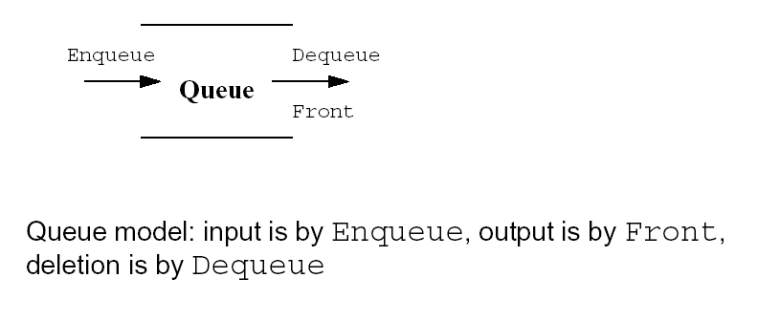
Queue Implementation
Using Arrays(static)
Using Pointers(dynamic)

Slide 19
Operations Performed on QUEUE
Insert (join)– adding element into queue
queue overflow condition may occur
Full check
Delete/remove (leave)– removing element from queue
Queue underflow condition may occur
Empty check
Operations are performed with rear and front.
First In First Out (FIFO)

Slide 20
Algorithm : Insert Element in QUEUE
Initialize front=0 and rear=-1
Input value to be inserted and assign variable “data”
If(rear>=SIZE) then
Display Queue Overflow
Exit
Else
Rear = rear + 1
Q[rear] = ELEMENT
Exit

Slide 21
Variations in QUEUE
Linear Queue
Circular Queue
Double Ended Queue (de-queue)
Priority Queue

Slide 22
Queue - Applications
Scheduling and buffering queues
A queue is natural data structure for a system to serve the incoming requests. Most of the process scheduling or disk scheduling algorithms in operating systems use queues.
Computer hardware like processor or a network card also maintain buffers in the form of queues for incoming resource requests
Messaging System
Queue - Search space exploration
Like stacks, queues can be used to remember the search space that needs to be explored at one point of time in traversing algorithms. Breadth first search of a graph uses a queue to remember the nodes yet to be visited.

Slide 23
Application
In a multitasking operating system, the CPU time is shared between multiple processes. At a given time, only one process is running all others are sleeping. The CPU time is administered by scheduler. The scheduler keeps all current processes in a queue with active process at front of the queue.
Process QUEUE
Next Process
D
C
B
A
Running Process

Slide 24
Application
Round –Robin scheduling – every process granted a specific amount of CPU time. Its ‘quantum’. If process is still running after quantum run out, it is suspended and put towards the end of queue.
Process QUEUE
Next Process
D
C
B
A
Running Process
A
D
C
B

Slide 25
Algorithm : Delete Element from QUEUE
Front=0 rear=-1
If rear < front then
Display queue is empty
Exit
Else
Data = q[front]
Front = front + 1
exit

Slide 26
Linked List
A linked list is a linear collection of specially designed data elements called nodes and linked to one another by means of pointer.
START
DATA
DATA
DATA

Slide 27
Advantages of LinkedList
Can grow and shrink during execution of program
Efficient memory utilization. Memory is not pre allocated. Allocate /de allocate memory as per need.
Insertion and deletion are easy and efficient.

Slide 28
Disadvantages
More memory required to store data and address for next node.
Access to an arbitrary data item is little bit cumbersome and time consuming.

Slide 29
Operations performed
Create – to create list start with one node
Insert
At first position
At last position
Any given position
Delete
At first position
At last position
Any given position
Traverse
Visiting each node from one end to another
Singly linked list only forward traverse
Doubly linked list forward backward traverse
Search
Concatenation appending one list to another

Slide 30
Types of Linked List
Singly linked list
Doubly linked list
Circular linked list

